Slide 1
App Development
Analysis
By: Alec Li

Slide 2
Table of contents
01
02
03
04
Introduction
Problem & Solution
Analytical Goals
Summary

Slide 3
01
Introduction

Slide 4
Introduction
Dataset
Data Analysis
This dataset was sourced from a third party source, kaggle.com, containing over 7200 rows with 16 columns providing information of over 7200 apps.
This dataset was cleaned using Python to remove null, duplicates, incorrect values. Analysis was performed using SQL specifically using SQLite and visualization was done using Tableau.

Slide 5
02
Problem & Solution

Slide 6
Problem & Solution
Problem
Solution
App developer needs data-driven insight on what kind of app to build.
What app categories are most popular?
What should the price point be set at?
How can user ratings be maximized
An exploratory data analysis of existing app database to measure performance and identify areas of high user rating and areas that can be improved upon.

Slide 7
03
Analytical Goals

Slide 8

Why develop an app?
There are over 6.3 billion smartphone users across the world with studies demonstrating that an average American:
Checks their phone over 262 times per day or once every 5.5 minutes
Uses over 10 apps per day and 30 apps per month
Opens an app 11+ times per day
The goal is to develop an app that will be the used once per day and can provide value to the user.

Slide 9
6.3 Billion
1.96 Million
$935 Billion
Smartphone users across the globe
Apps on the Apple App Store
Estimated Revenue for Mobile Apps in 2023

Slide 10
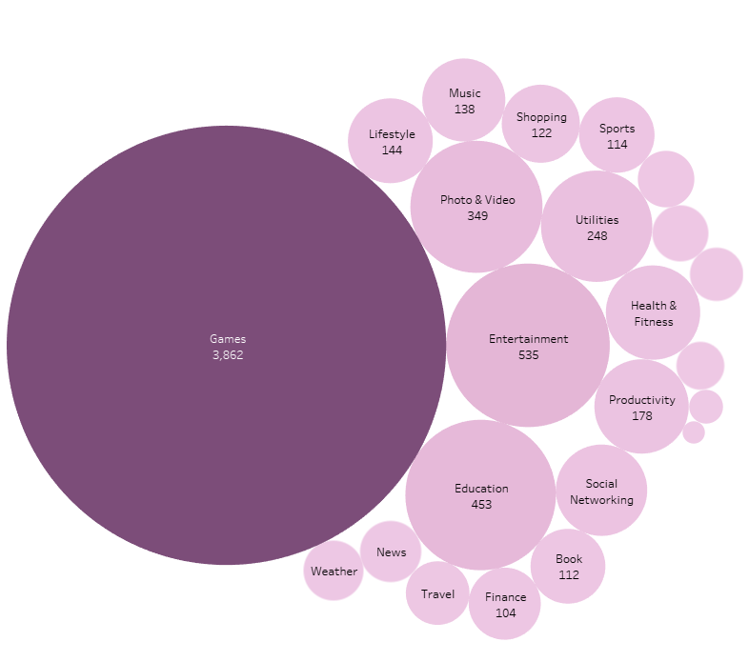
What app categories are most popular?
53.67%
7.4%
6.29%
Of Apps are Games
Of Apps are Entertainment
Of Apps are Education

Slide 11
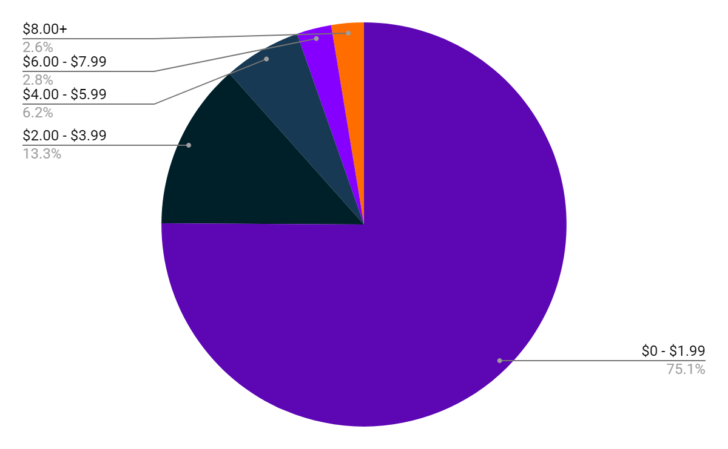
App Distribution by Price
$0 - $1.99
$2.00 - $3.99
$4.00 - $5.99
$6.00 - $7.99
$8.00+
75.1%
13.3%
6.2%
2.8%
2.6%

Slide 12
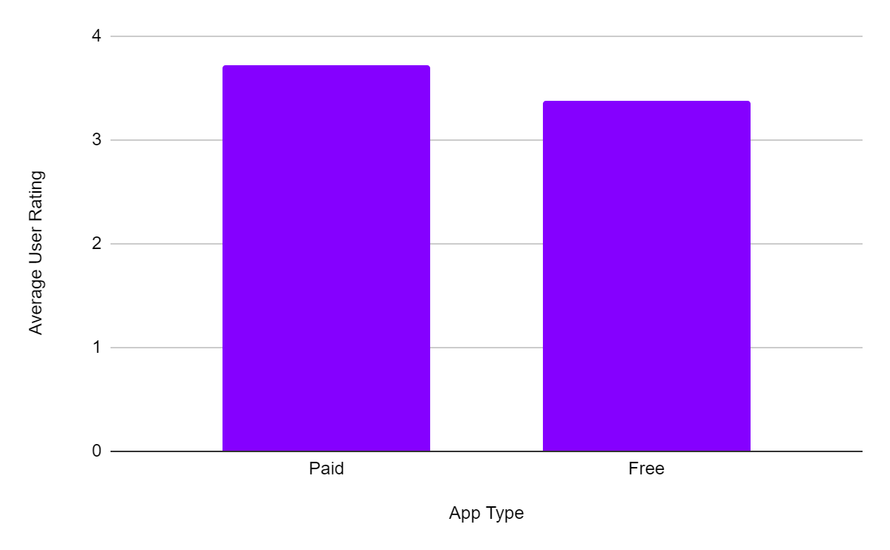
User Rating by Price

Slide 13
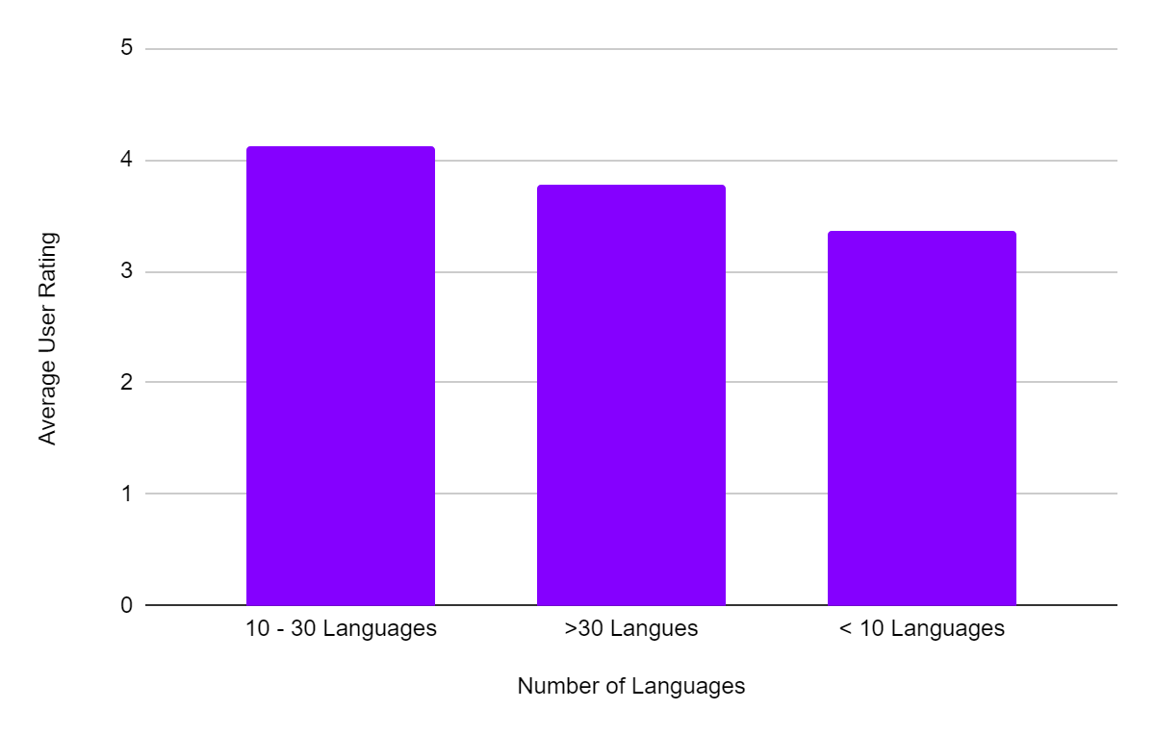
User Rating by Number of Languages

Slide 14
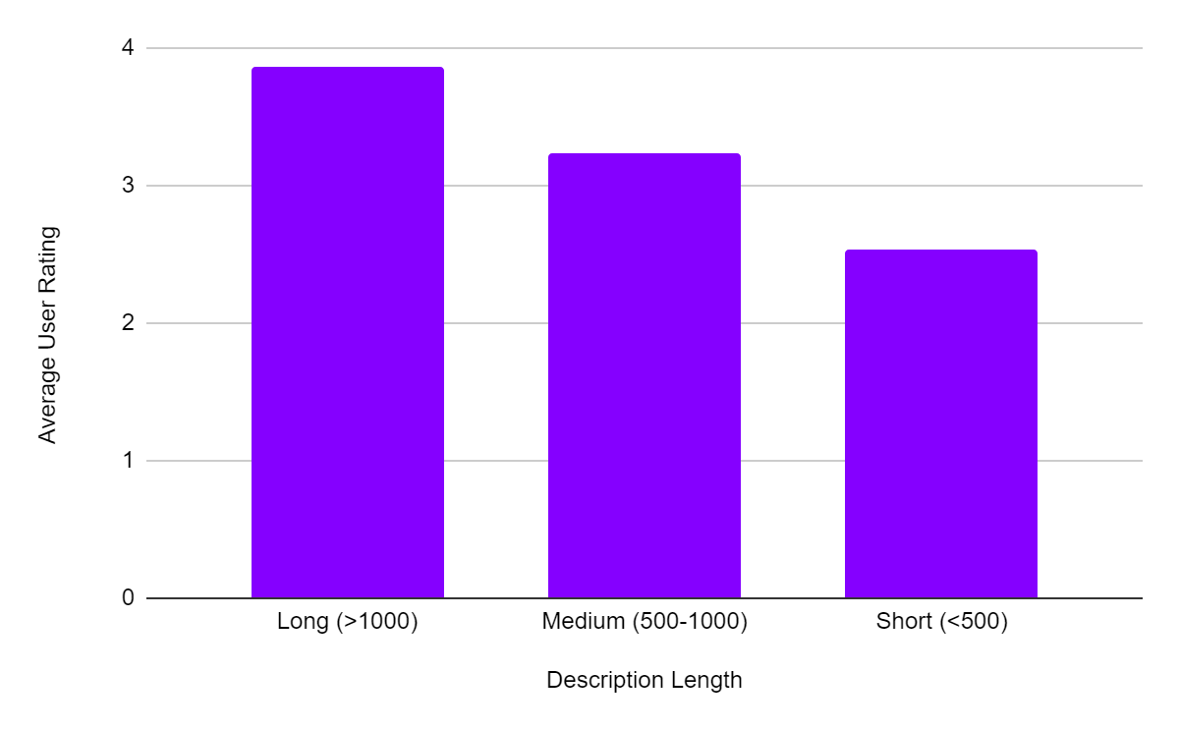
User Rating by Description Length

Slide 15
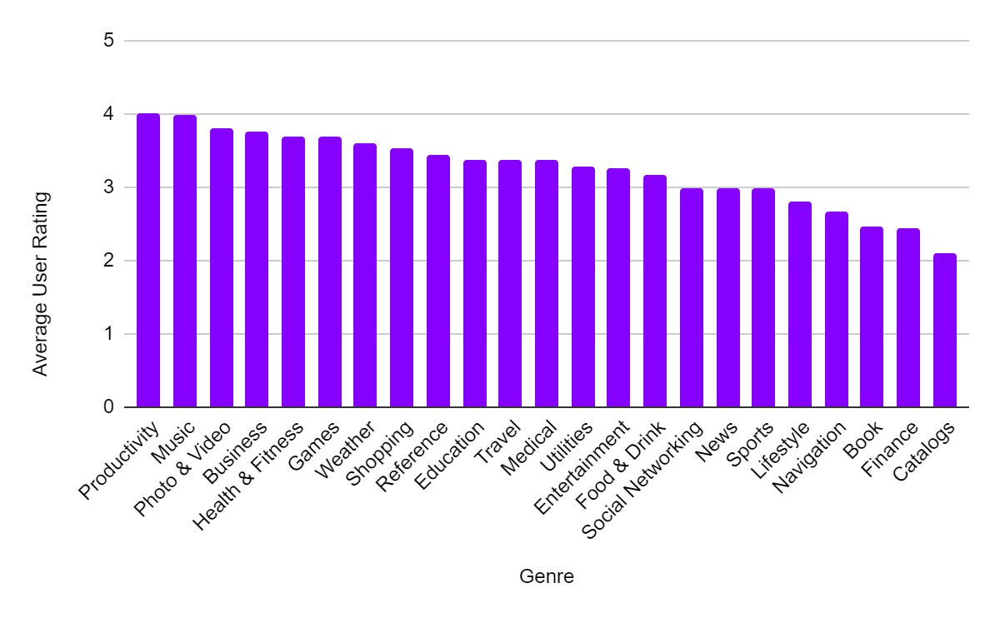
User Rating by Genre

Slide 16
04
Summary

Slide 17
Key Insights
Paid apps have better ratings thus we should gear towards paid apps
Apps with 10-30 languages have the highest number of ratings
Those with longer description lengths have better ratings
A new app should strive for a rating over 3.5
The categories with the highest number of apps are Games and Entertainment thus highest competition
Thus when developing a new app it should target all of these areas for the best rating.

Slide 18
Other Potential Plans
Low Competition
Low Ratings
Develop an app that can outcompete other apps in that category providing users with one stop solution for their problems and ensuring they need your app.
Knowing that categories such as Finance and Books have the lowest ratings. Understand competitors flaws and develop an app that addresses their flaws allowing for highest rating.
Attempt to Compete
Understanding categories such as Games and Entertainment have the highest number. There must also be a big market and thus an opportunity.

Slide 19
Thank You!

